Slide 1


Kubernetes 2: TOols
Angel Sevilla Camins

Slide 2


planning
Helm
Prometheus and Grafana
Istio

Slide 3

1. helm

Slide 4
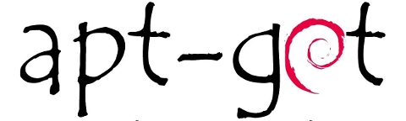

1. Helm Package Managers
A package manager should:
Automatically install software.
Automatically install dependencies.
Version control, including upgrade software.
Automated removal of packages

Slide 5
1. helm
Helm is the Kubernetes package manager, it can:
Install software.
Automatically install software dependencies.
Upgrade software.
Configure software deployments.
Fetch software packages from repositories.
https://www.digitalocean.com/community/tutorials/an-introduction-to-helm-the-package-manager-for-kubernetes

Slide 6
1. Helm Helm COMPONENTS
Helm has two major components:
1. Helm Client is a command-line client for end users. The client is responsible for the following domains:
Local chart development
Managing repositories
Interacting with the Tiller server
Sending charts to be installed
Asking for information about releases
Requesting upgrading or uninstalling of existing releases
https://helm.sh/docs/architecture/

Slide 7
1. Helm Helm COMPONENTS
Helm has two major components:
2. The Tiller Server is an in-cluster server that interacts with the Helm client, and interfaces with the Kubernetes API server. The server is responsible for the following:
Listening for incoming requests from the Helm client
Combining a chart and configuration to build a release
Installing charts into Kubernetes, and then tracking the subsequent release
Upgrading and uninstalling charts by interacting with Kubernetes
NO LONGER USED IN version 3
In a nutshell, the client is responsible for managing charts, and the server is responsible for managing releases.
https://helm.sh/docs/architecture/

Slide 8
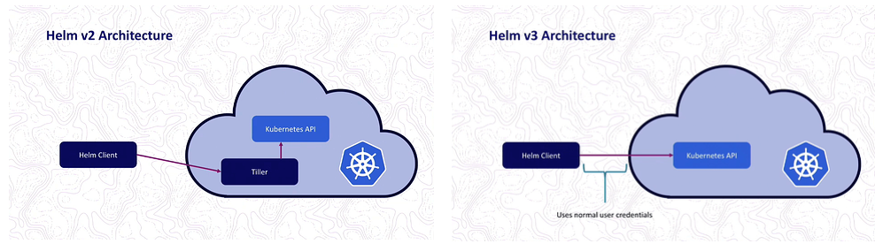
1. Helm Helm COMPONENTS
https://www.padok.fr/en/blog/helm-3-commands

Slide 9
1. Helm Helm Architecture
For Helm, there are three important concepts:
The chart is a bundle of information necessary to create an instance of a Kubernetes application.
The config contains configuration information that can be merged into a packaged chart to create a releasable object.
A release is a running instance of a chart, combined with a specific config.
https://helm.sh/docs/architecture/

Slide 10
Helm Helm Architecture
Kubernetes packages are called charts.
Helm can:
Create new charts from scratch
Package charts into chart archive (tgz) files
Interact with chart repositories where charts are stored
Install and uninstall charts into an existing Kubernetes cluster
Manage the release cycle of charts that have been installed with Helm
https://helm.sh/docs/architecture/

Slide 11
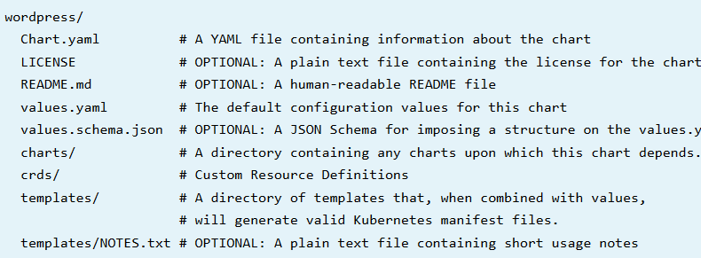
1. Helm Helm Chart v3
https://helm.sh/docs/topics/charts/

Slide 12
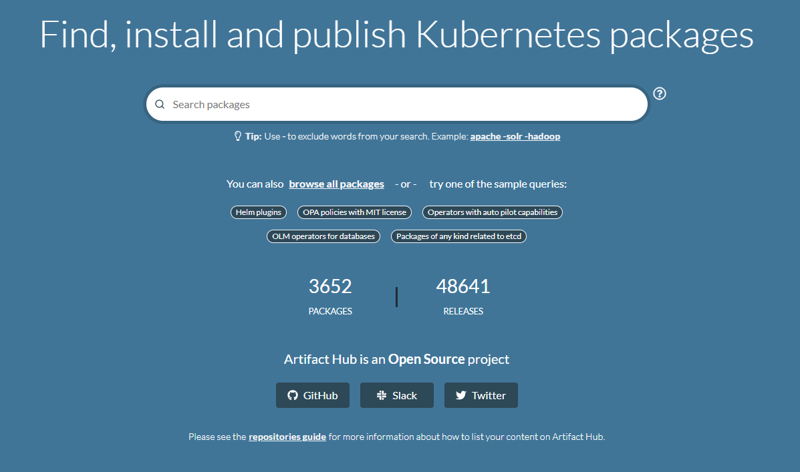

1. Helm Helm Chart repositories
https://artifacthub.io/

Slide 13

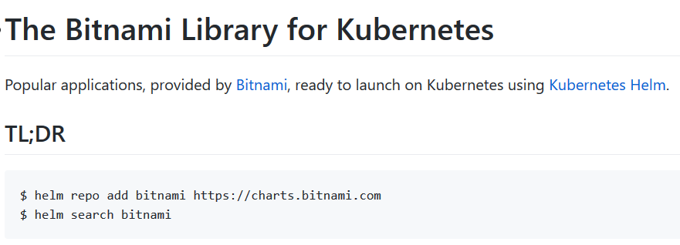
1. Helm Helm Chart repositories
https://github.com/bitnami/charts

Slide 14





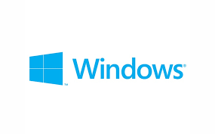
1. Helm Helm INSTALL

Slide 15
1. Helm Helm Customizing
helm fetch --untar
edit values.yaml
helm install

Slide 16

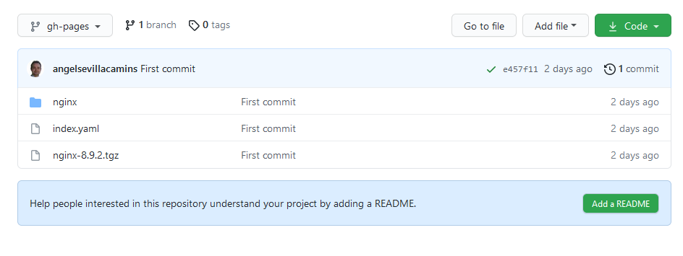
1. Helm Helm Private repository

Slide 17

2. Prometheus and Grafana

Slide 18

2. Prometheus and Grafana
Open-source systems monitoring and alerting toolkit, its main features are:
A multi-dimensional data model with time series data identified by metric name and key/value pairs
PromQL, a flexible query language to leverage this dimensionality
No reliance on distributed storage; single server nodes are autonomous
Time series collection happens via a pull model over HTTP
Pushing time series is supported via an intermediary gateway
Targets are discovered via service discovery or static configuration
Multiple modes of graphing and dashboarding support
https://prometheus.io

Slide 19
2. Prometheus and Grafana
There are some important concepts:
Alert is the outcome of an alerting rule.
PromQL is the Prometheus Query Language.
Target is the definition of an object to scrape.
https://prometheus.io

Slide 20
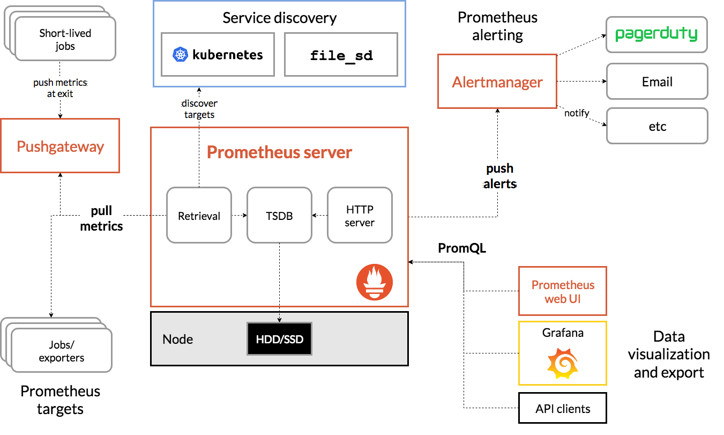
2. Prometheus and Grafana Architecture
https://prometheus.io

Slide 21
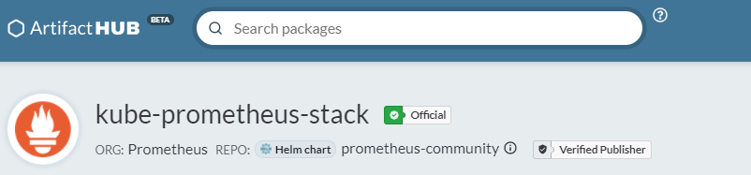
2. Prometheus and Grafana Install Prometheus
https://artifacthub.io/packages/helm/prometheus-community/kube-prometheus-stack

Slide 22

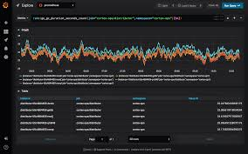
2. Prometheus and Grafana Grafana
The analytics platform for all your metrics.
Features:
Grafana allows you to query, visualize, alert on and understand your metrics no matter where they are stored.
Create, explore, and share dashboards with your team and foster a data driven culture.
https://grafana.com/grafana

Slide 23
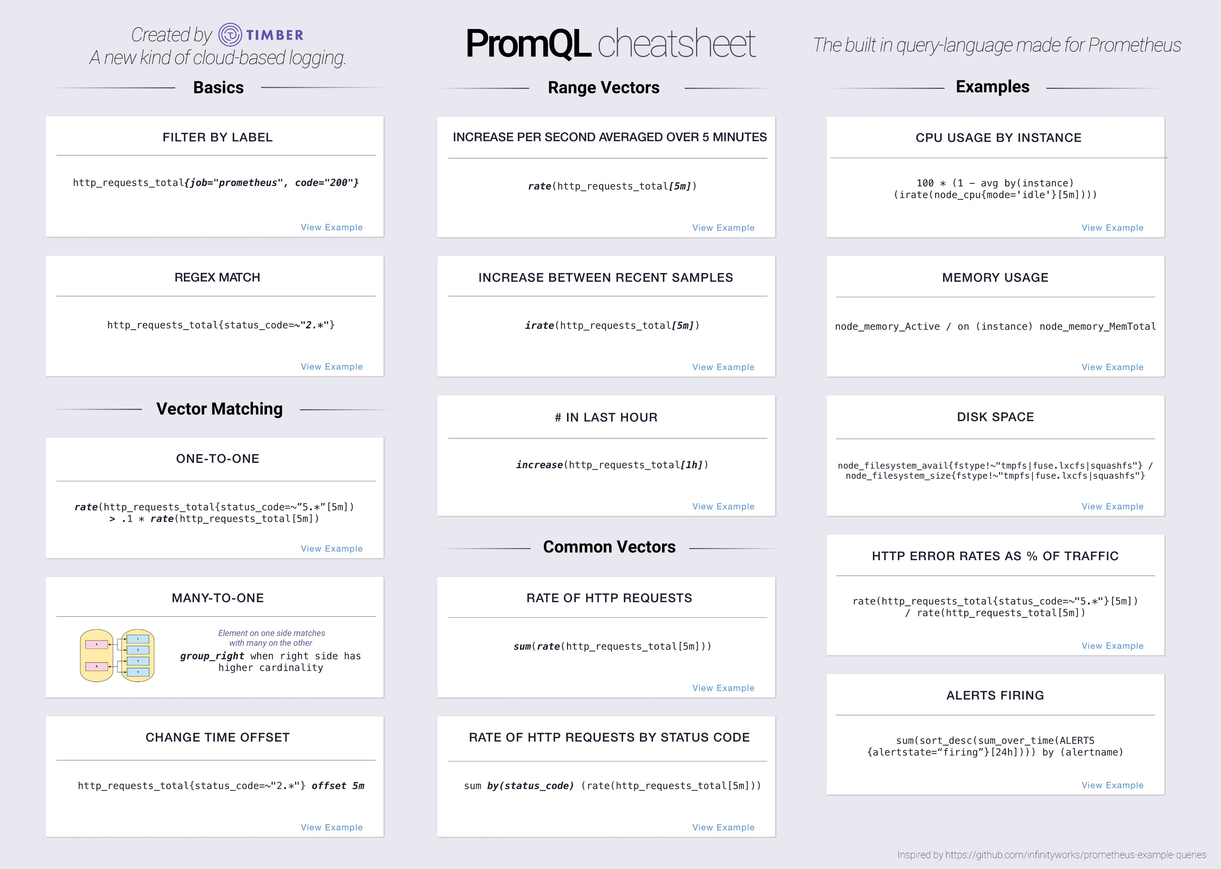
2. Prometheus and Grafana PromQL
Querying Prometheus:
Prometheus provides a functional query language called PromQL (Prometheus Query Language) that lets the user select and aggregate time series data in real time
https://timber.io/blog/promql-for-humans/

Slide 24
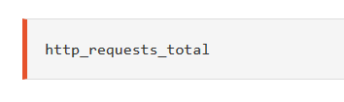
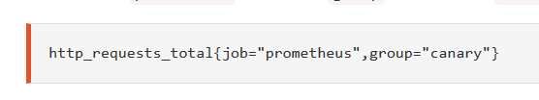
2. Prometheus and Grafana PromQL
Instant vector selectors allow the selection of a set of time series and a single sample value for each at a given timestamp (instant): in the simplest form, only a metric name is specified
With curly braces, we can filter:
https://prometheus.io

Slide 25
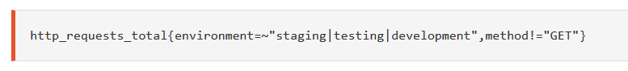
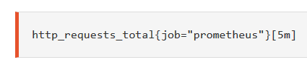
2. Prometheus and Grafana PromQL
Instant vector selectors with filtering by regex:
Ranges with []:
https://prometheus.io

Slide 26
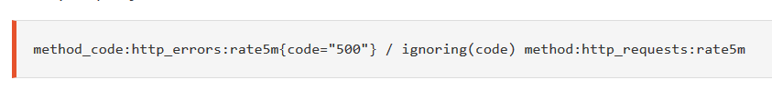
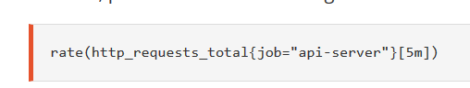
2. Prometheus and Grafana PromQL
Operators:
Aggregation via functions such sum, rate,…:
https://prometheus.io

Slide 27
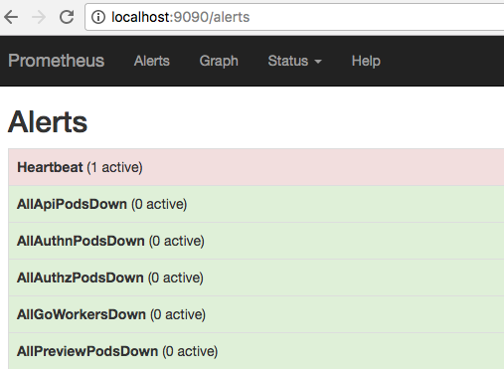
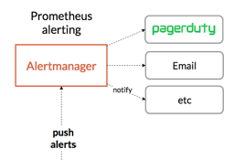
2. Prometheus and Grafana Alerts
https://prometheus.io

Slide 28
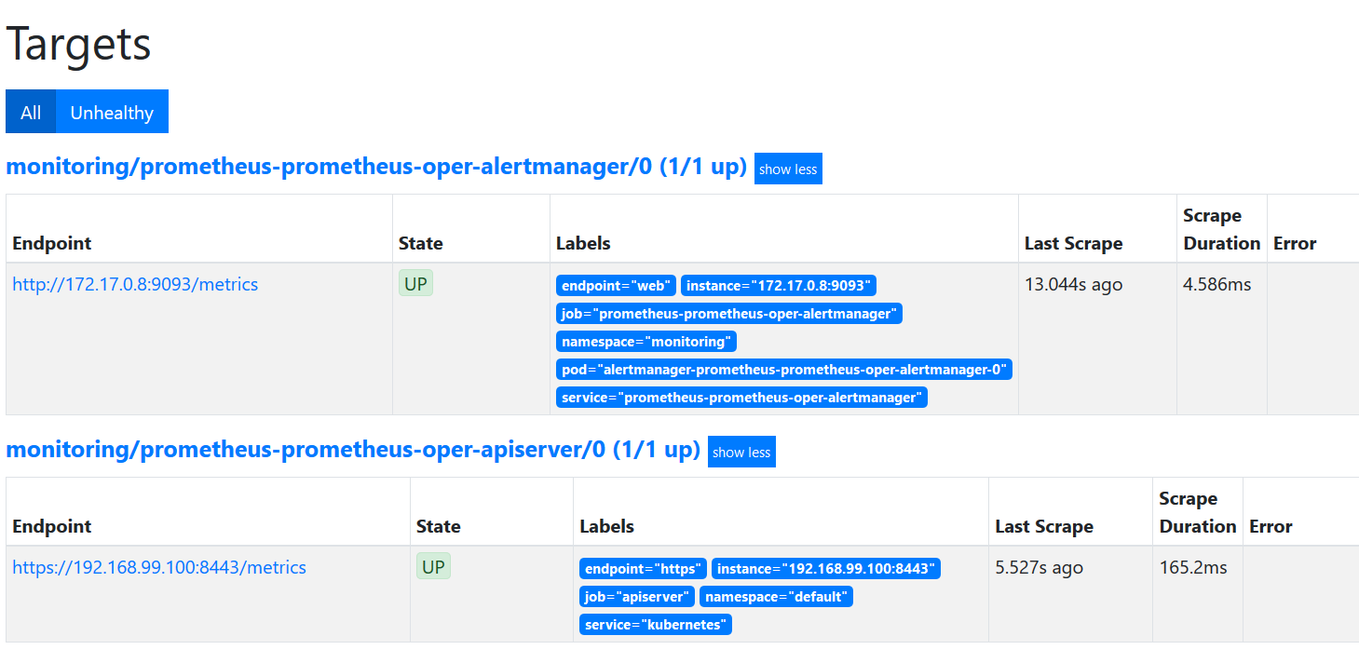
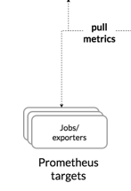
2. Prometheus and Grafana Targets
https://prometheus.io

Slide 29
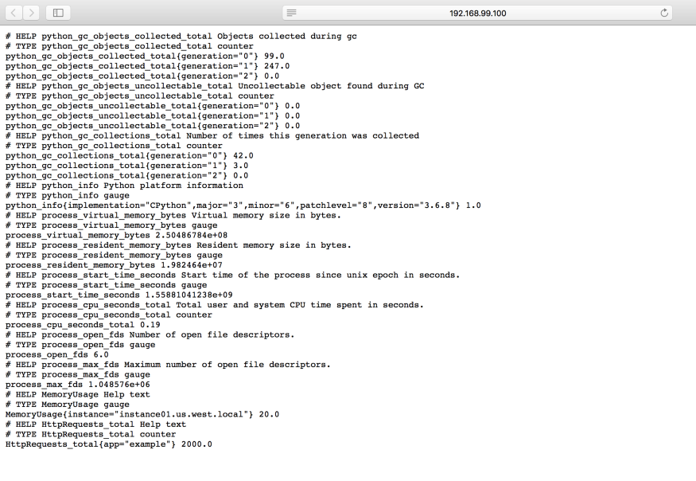
2. Prometheus and Grafana Targets
https://prometheus.io

Slide 30

3. istio

Slide 31
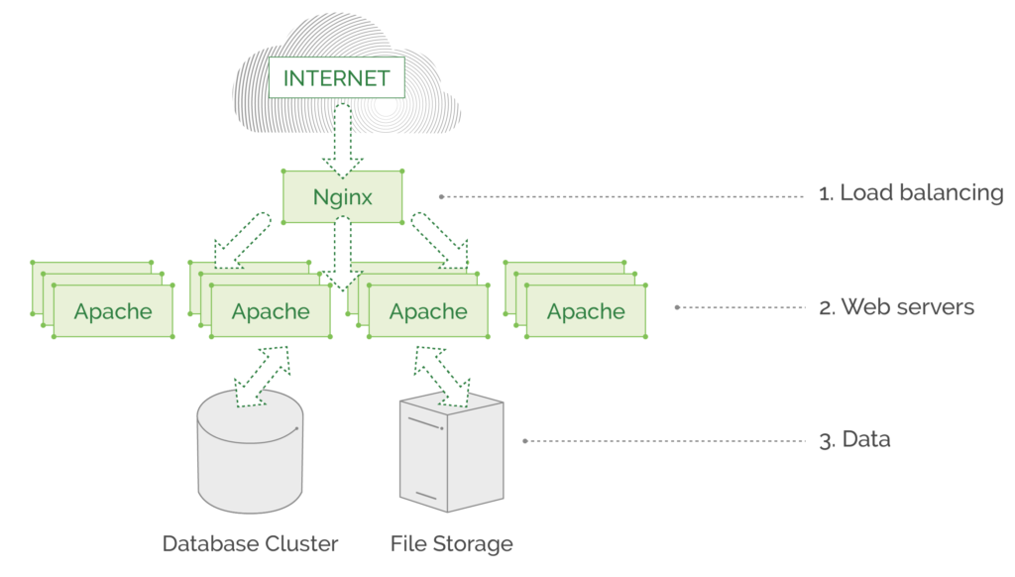
3. Istio past: Your father’s service

Slide 32
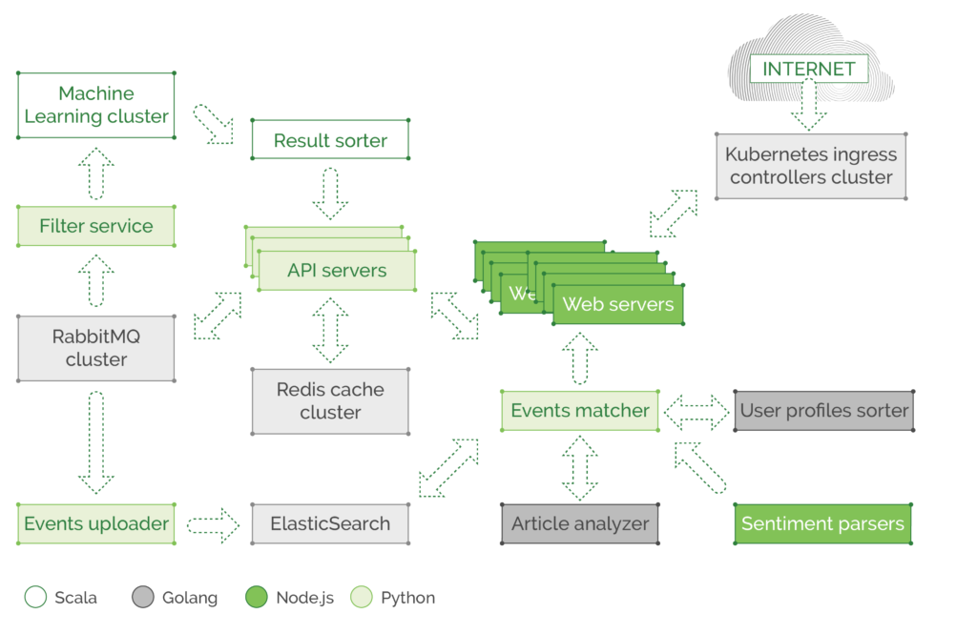
3. Istio now: Microservices everywhere

Slide 33
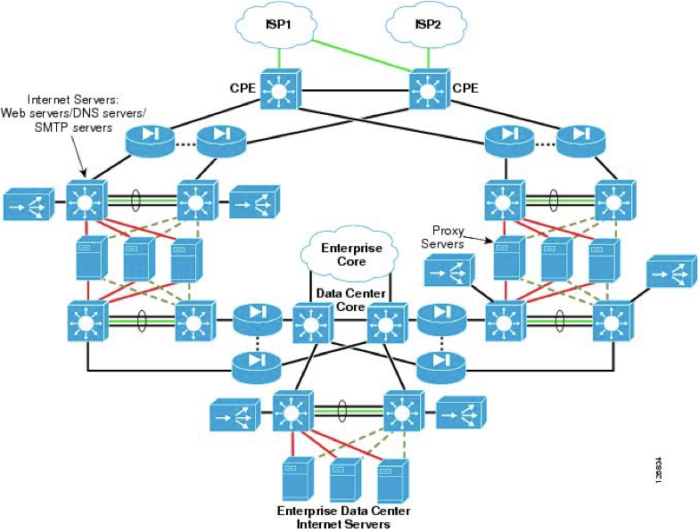
3. Istio Fallacies of distributed computing
1. The network is reliable
2. Latency is zero
3. Bandwidth is infinite
4. The network is secure
5. Topology doesn't change
6. There is one administrator
7. Transport cost is zero
8. The network is homogeneous
- Peter Deutsch and others at , around 1994

Slide 34
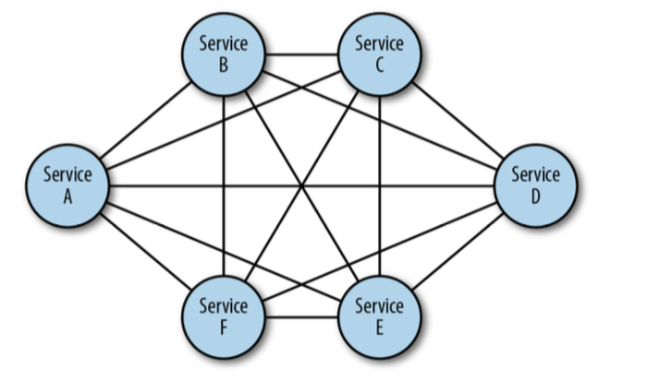
3. Istio What do we want out of our network?
The network connecting our services should:
Be as intelligent and resilient as possible
Route traffic away from failures
Avoid overhead (high latency routes, cold caches)
Be secured against trivial attack (zero trust networking)
Give insight into failures and/or congestion
Support fine grained policies at the service level (not just at the connection level)
In short we want a services-first network and we don’t want to write all this into our application code! We want a service mesh!

Slide 35
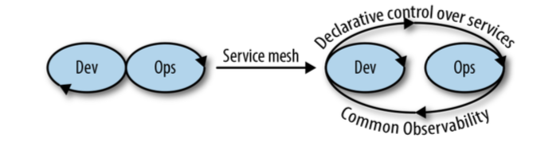
3. Istio Value of a service mesh
The network connecting our services should provide:
observability
traffic control
security
delay and fault injection
decoupling of development and operational concerns

Slide 36
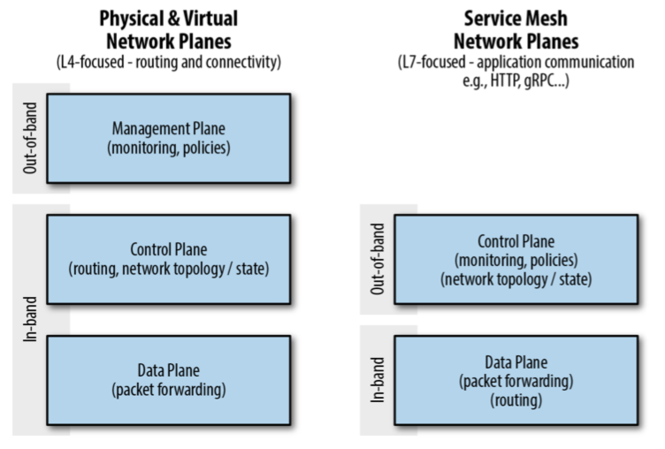
3. Istio SERVICE MESH architecture and components
Division of concerns:
Control plane: out-of-band management and control
Data plane: in-band packet forwarding and routing

Slide 37
3. Istio Istio architecture and components
Control plane: out-of-band management and control
Mixer: Enforces access control and usage policies and collects telemetry data.
Pilot: Provides service discovery and traffic management (resiliency and intelligent routing)
Citadel: Provides service-to-service and end-user authentication. Enables encrypted traffic in the service mesh (mTLS and PKI).
Galley: Obtains configuration from underlying system (e.g. Kubernetes)
Data plane: in-band packet forwarding and routing
Intelligent proxies: usually Envoy deployed as sidecar containers. These proxies mediate and control all network communication between microservices

Slide 38
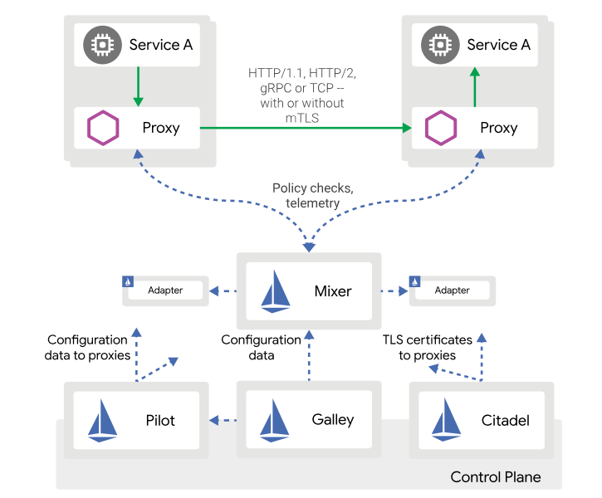
3. Istio Istio architecture and components

Slide 39
3. Istio Istio features
Observability:
Visualize mesh (lab)
Distributed tracing
Logs and metrics
Traffic control:
Rate limiting
White/black listing
Request routing (lab)
Traffic shifting
Defining timeouts
Mirroring
Circuit breaking
Security:
Mutual TLS
CA/PKI
Authentication and authorization of services and clients
Fault injection:
Fault injection
Delay injection

Slide 40
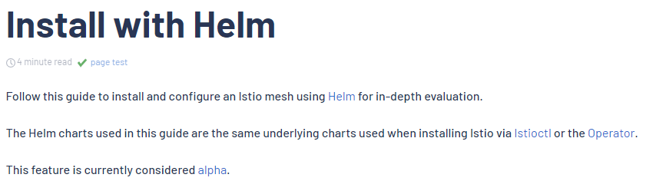
3. Istio INSTALLING ISTIO

Slide 41
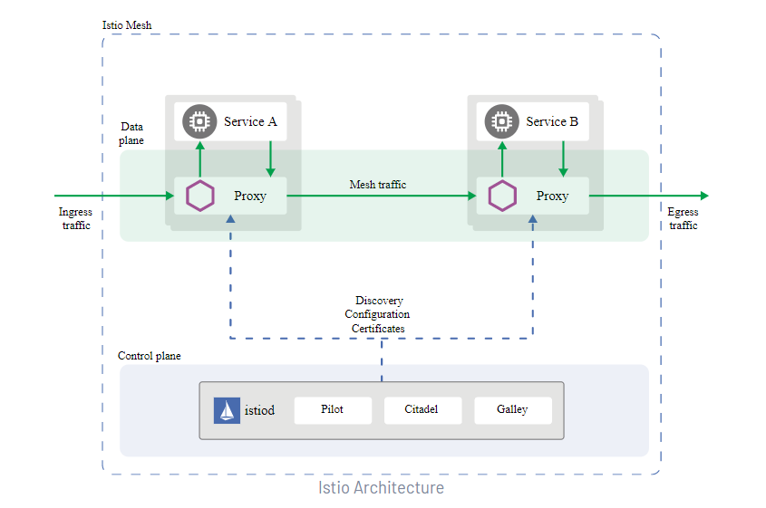
3. Istio ISTIO requirements on Pods and SERVICES
TCP Ports used by istio components should not be in use by other services.
Service ports should be named: <protocol>—suffix to make use of routing policies. E.g. http-foo.
Supported services: {grpc, http, http2, https, mongo, redis, tcp, tls, udp}
Explicitly expose pod ports (containerPort in pod spec). Unlisted ports bypass the proxy.
Pods must be associated with at least one Kubernetes service.
Label pods; labelling propagated to telemetry
NET_ADMIN capability required if not using the new CNI plugin. Having NET_ADMIN might violate security compliance.

Slide 42
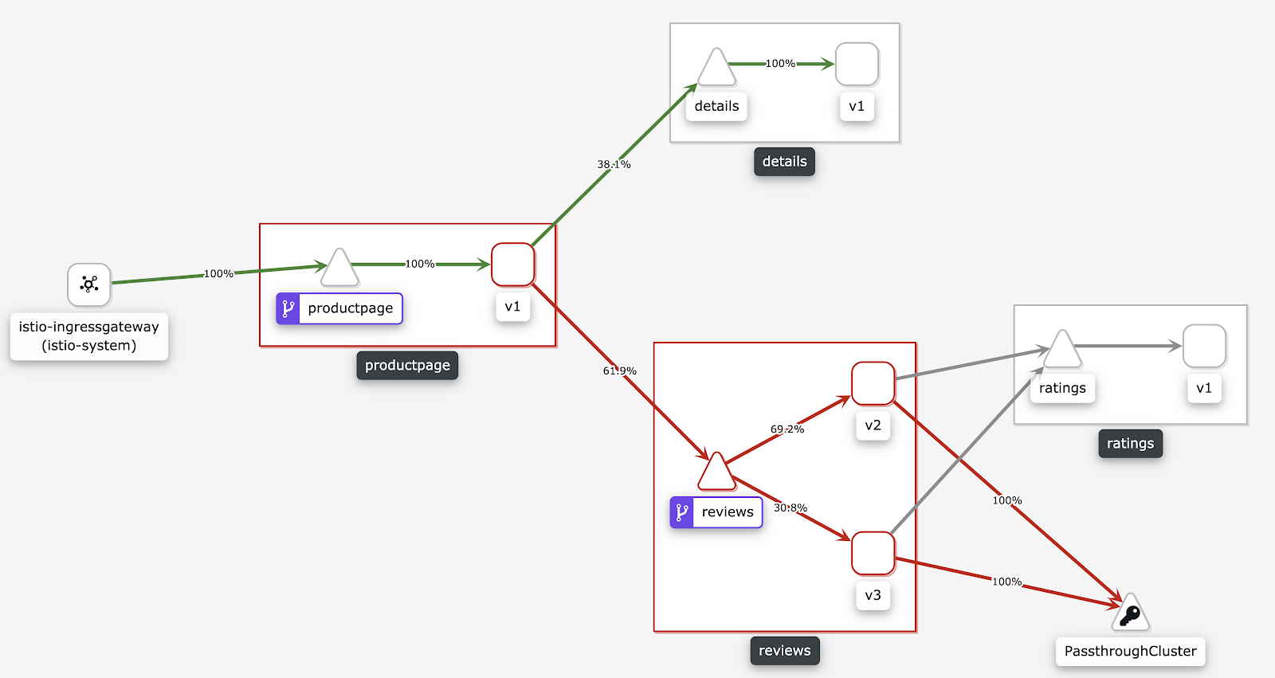
3. Istio Istio performance impact
Not evaluated, but:
Requests per second on Istio telemetry is a factor of the RPS on services.
Tracing is expensive; requires application to propagate tracing headers.
Mixer component in request path. Scalable but can have high load for very large meshes. Susceptible to cascade failure

Slide 43
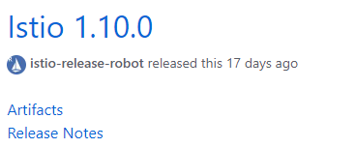
3. Istio Istio maintenance and upgrading
Project is young and will break backwards compatibility.
Upgrades may will result in service downtime -> HA services, multiple replicas, multiple clusters …
To upgrade sidecars rolling upgrade of deployed pods is required

Slide 44
3. Istio Summing up
”Shut up, just shut up. You had me at hello”:
Out of the box observability!
Out of the box PKI and mTLS!
Traffic routing, traffic mirroring options
”You’re gonna need a bigger boat”:
More moving parts, complex upgrades/maintenance.
Black box infrastructure: circuit breaking with no fallbacks.
Configuration not always intuitive and/or trivial
(requiring superior YAML indentation skills and knowledge).
“Service meshes will help prevent service messes.”

Slide 45
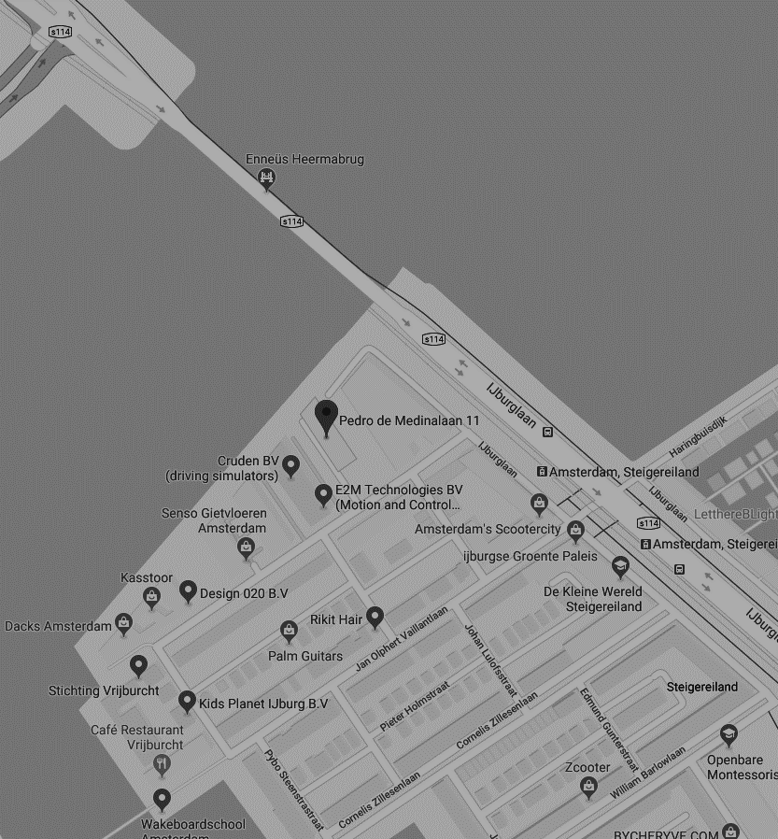
THANK YOU FOR YOUR ATTENTION
Pedro de Medinalaan 11, 1086 XK Amsterdam
020 - 773 1972
www.anchormen.nl

